Slide 1
Data Enabled Prediction of Elastic Constants of Multi-Component Alloys
Project Proposal for ME 793 - 2022
Team ID : 10
Avish Wagde 180100023 Bimlesh Kumar Shah 213102007 Shridhar N 190100113

Slide 2
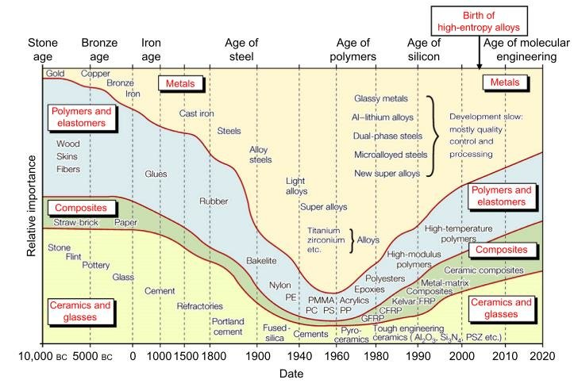
Background of problem
Why is it Important?
The knowledge of materials characteristics allows the designer:
Best material selection
Overcome limits and constraints in the design path
To produce a design in the most appropriate way possible
With the fast materials evolution
Materials availability and production is increasing
Similarly also differentiating characteristics are widening.
The implicit difficulty of constantly being up-to-date
Lack of knowledge turns into a loss of opportunities
The future of materials selection seems complex than ever

Slide 3
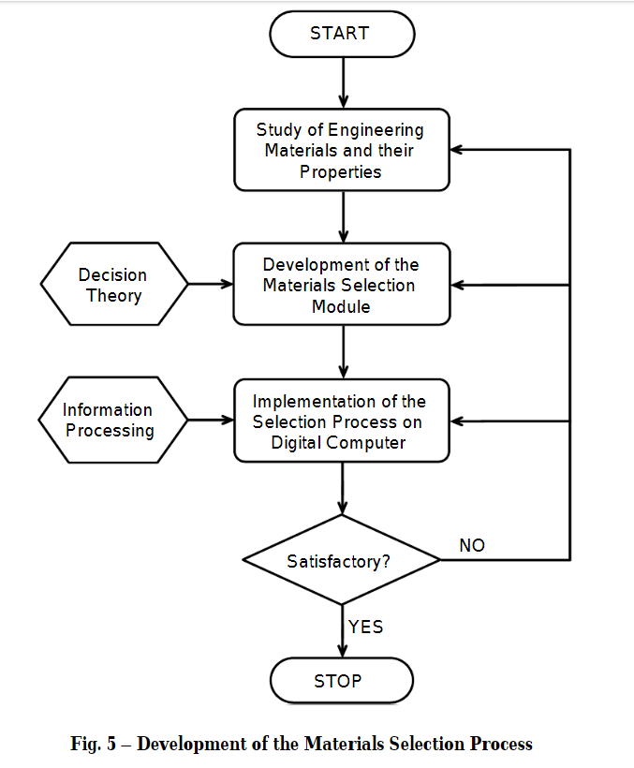
Traditional Processes
Case-by-case manner based on chemical intuition
Prototyping and validating using trial-and-error
Using data drawn from materials and design handbooks
Evaluating available products and processes and modifying them based on requirements
Shortcomings
Doesn’t consider the dynamic nature of Materials Selection

Slide 4
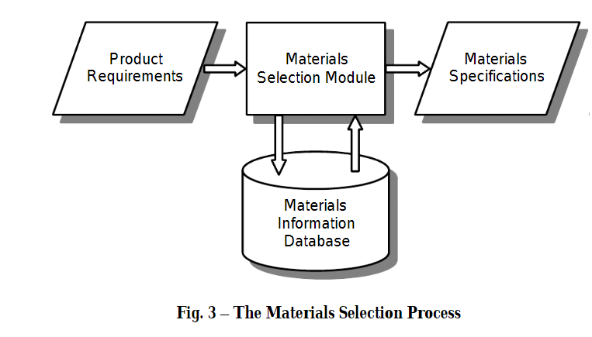
Motivation
ML route offers a much more efficient path towards targeted materials design, discovery and optimization
Reduces the time and resources required
Allows one to survey complex multiscale data and extract meaningful information
Objective
To determine elastic constants and other derived mechanical properties of multi-component alloys
To systematically select effective features for prediction
To analyze property trends to further understand the achieved performance
To use various ML models for better accuracy

Slide 5
Recent Research Studies
Furmanchuk et. al. (2016) trained a random forest (RF) regressor on the compounds with bulk modulus (B) values of up to 250 GPa the model was shown to predict B within a mean absolute error (MAE) of 13.58 GPa.
A gradient boosting regressor was capable of providing good estimates for B(Bulk Modulus) and G(Shear Modulus), closely matching the best DFT predictions on silica zeolites
Wang et. al. (2017) used several ML models, including neural networks (NNs) and support vector machines to predict elastic constants Cij of binary alloys.

Slide 6
Methodology
Testing
Binary Alloy Data
Feature Selection
Optimize Hyperparameters
Results
Training

Slide 7
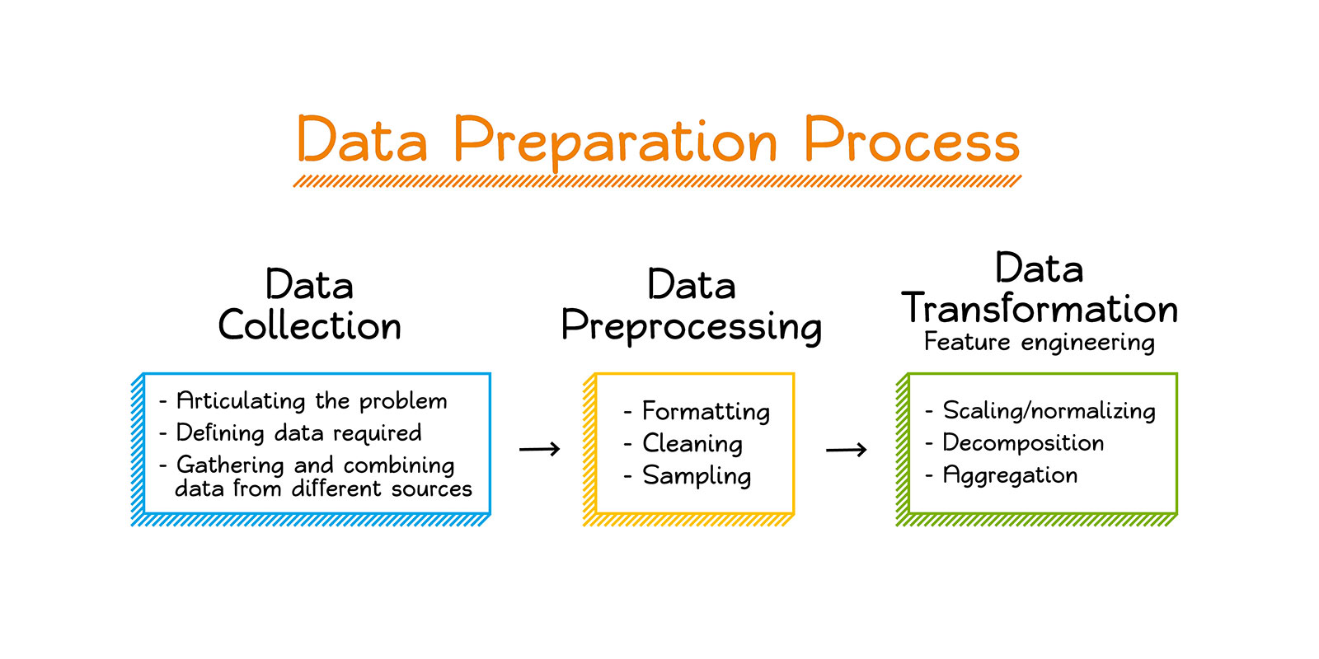
Tools:
Data?
Python
Google Colab or Jupyter Notebook
ML Libraries - Numpy, SKLearn, Pymatgen, etc
Data visualization tools - Pandas, seaborn
Data will be acquired from Materials project database using automation functionality available within the pymatgen library
Some other sources being explored

Slide 8
Timeline
Data Collection
Gathering data from various sources , Literature Review
Feature Selection
Feature Selection, Test and Train data
WEEK 2
WEEK 4
WEEK 1
WEEK 3
Data Analysis
Applying Data transformations and visualization, Checking correlation between features
Various Models for Prediction
Training and Evaluating different models,
Models optimization, Finishing up Report

Slide 9
Challenges
Data collection, API, pymatgen
Data Preprocessing, some libraries
Feature Selection
Using different Models for the purpose (Increasing accuracy if possible)

Slide 10
Thank You

